Slide 1
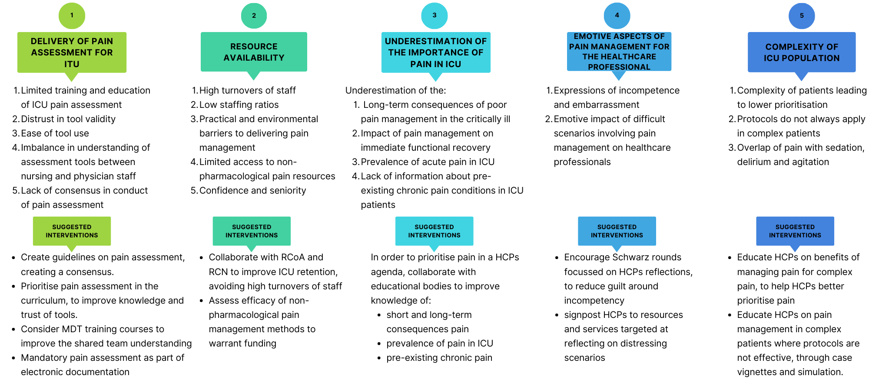
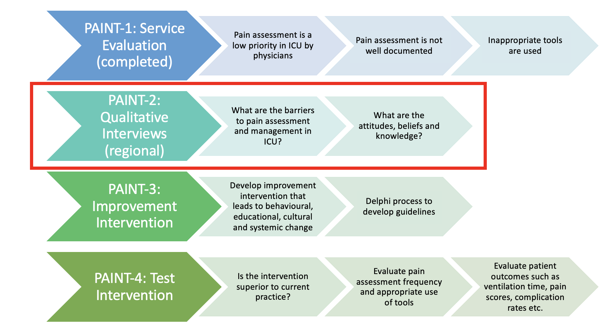
A Qualitative Investigation of Healthcare Professionals’ Perceptions, Values and Attitudes Towards Pain Management in the Intensive Care Unit (PAINT-2)
Adrija Bhattacharyya¹, Helen Laycock², Frances Beatty³, Stephen Brett², Harriet Kemp²
1. Imperial College London School of Medicine 2. Anaesthetics, Pain Medicine and Intensive Care, Department of Surgery and Cancer, Imperial College London, Chelsea and Westminster Hospital, 369 Fulham Road, London SW10 9NH, UK 3. Guy’s and St Thomas’ NHS Foundation Trust
Introduction
Methods
An estimated 50-77% of patients in the intensive care unit (ICU) experience moderate to severe pain^{1,2}.
Many ICU patients are sedated or intubated so are unable to self-report pain³.
Simply assessing pain using validated tools (e.g. CPOT, BPS) has been shown to improve ICU specific outcomes such as mortality or length of time on mechanical ventilation⁴.
Despite this, pain assessment remains poor e.g. a study of London ICUs demonstrated very limited use of validated pain scales and no documentation of pain assessment in 29%⁵.
Aims: determine themes and barriers to effective pain management and assessment that could be targeted with specific interventions or quality improvement initiatives to improve pain management as depicted in figure 1.
Data Collection: 30 physicians and nurses working on eight diverse London ICUs were recruited using purposive sampling. All completed informed consent to audio recording. Recruitment ceased when thematic saturation had been achieved based on the consensus of the interviewers. Semi-structured interviews were performed using an interview guide resulting in 24 hours 48 minutes of interviews.
Analysis: Transcribed interviews were analysed using NVivo12.7.0 by an inductive thematic analysis technique. Higher order analytic themes were created. Supporting quotations were identified and subthemes created.
This study received HRA approval (IRAS223140) and all participants provided written consent
Figure 2: A figure demonstrating the five themes created from the interviews along with their subthemes and suggestions for targeted interventions.
Theme 1: Delivery of Pain Assessment for ICU
“I know scoring systems do exist. I know that nurses were generally pretty good at using them. But as doctors we didn’t really do so much of that, so I don’t actually know what they are” – Junior Clinical Fellow”
Conclusions
Results
Theme 2: Resource Availability
“The nursing side is desperately short and doubling up patients that, potentially, they shouldn’t be doubling up… you sometimes don’t get back to your second patient for over an hour, in which case that patient may have had pain symptoms that go unnoticed” – Senior Nurse
30 healthcare professionals were interviewed from across 8 ITUs. 4 Specialist Registrars, 6 Consultants, 9 Specialist House Officers/Core Trainees/Clinical Fellows, 7 junior nurses, 4 senior nurses were recruited. Their workplaces included general, cardiac and specialist ICUs in tertiary and district general hospitals
Five main themes with subthemes were constructed, summarising perceptions, values and attitudes towards pain assessment and management. Themes with a selection of subthemes and intervention suggestions are displayed in figure 2. Example quotations are shown in figure 3.
This novel study is the first to assess challenges and attitudes towards effective in both physicians and nurses within ICU. It provides qualitative insight into healthcare professionals’ perceptions values and attitudes towards pain assessment and management in ICU and acts as a springboard to develop targeted interventions that promise to improve future care.
Theme 3:Underestimation of the Importance of Pain in ICU Population
“But for me the real thing was when I started doing follow-up and I felt like I’d let the patients down in not giving them better analgesia” – Consultant
Theme 4: Emotive Aspects for Healthcare Professionals
”I feel like I have failed that patient… I feel there is often no excuse” – Specialist Registrar
Theme 5: Complexity of ICU population
“If we’re talking about a patient whose fallen in a septic heap and they’re immediately life threateningly ill, then no I wouldn’t say that pain is the first thing that your mind goes to…. I wouldn’t put it in my top three priorities in a really critically unwell patient” – Foundation Year 2
References
Chanques G et al. Impact of systematic evaluation of pain and agitation in an intensive care unit. Crit Care Med. 2006
Gélinas C. Management of pain in cardiac surgery ICU patients: Have we improved over time? Intensive Crit Care Nurs 2007
Gélinas C. Pain assessment in the critically ill adult: Recent evidence and new trends. Intensive and Critical Care Nursing. 2016
Payen JF et al. Pain Assessment Is Associated with Decreased Duration of Mechanical Ventilation in the Intensive Care Unit. 2009
Kemp HI et al. Pain Assessment in INTensive care (PAINT): an observational study of physician-documented pain assessment in 45 intensive care units in the United Kingdom. Anaesthesia. 2017
Acknowledgements
Funding: This study is supported by a grant from the Association of Anaesthetists of Great Britain and Ireland via the National Institute of Academic Anaesthesia.
Competing Interests: None declared
Figure 1: Proposed components of the PAINT study aiming to improve pain assessment and management in intensive care units (ICUs). The current study is highlighted in red with the previous study and next steps shown.
Figure 3: Figure demonstrating the five main themes of the study with example quotations taken from the interviews. ICU = intensive care unit.

